Slide 1



Europe Telecommunications ISAC
TELCO SECURITY LANDSCAPE 2025
ENISA Telecom and Digital Infrastructure Security Forum 2025
20TH March 2025, Amsterdam, The Netherlands

Slide 2

DECIDE on the topics for information exchange and meeting set-up
THE WHY, WHAT & HOW OF
EXCHANGE use cases & best practices with your peers on a regular basis
☑️non-profit / collaboration platform within the European telco industry
☑️30+ physical meetings annually
☑️100+ webinars annually
☑️30+ years of building trust
Have DIRECT discussions with your peers instead of intermediate parties
Engage in a TRUSTED environment (no media involved)
LEARN from telcos and vendors
(no sales pitches allowed)
Collaborate on the FULL SPECTRUM
(both failures and success stories)
ACCESS exclusive Benchmarks and Surveys
www.etis.org

Slide 3










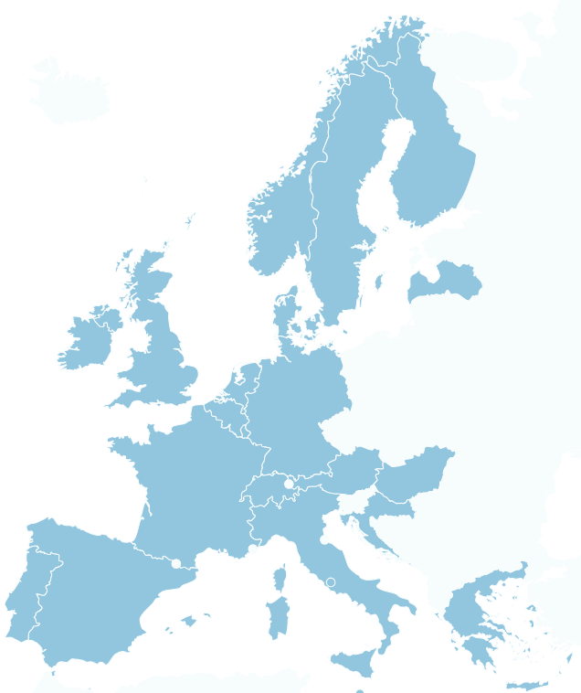




















31
PARTNERS

Slide 4

Continuously focusing on TOP telco priority domains
☑️ Sustainability​
☑️ AI Strategy​
☑️ Cyber security​
☑️ Energy Reduction
☑️ Digital Transformation
☑️ Data Privacy​
☑️ Cloud Transformation
☑️ Customer Success
☑️ Growth scenarios
☑️ 5G and FTTH strategy
and more...

Slide 5




























ETIS – Europe’s Telecommunications ISAC
DIGITAL TELCO STRATEGY FORUM
ENERGY REDUCTION TASK FORCE
NETWORK + IT TRANSFORMATION WG
CLOUD WG
ENTERPRISE ARCHITECTURE
WORKING GROUP
BUSINESS CONTINUITY
TASK FORCE
INFORMATION SECURITY WG
SECURITY AWARENESS TASK FORCE
CERT-SOC
WORKING GROUP
ANTI-ABUSE
WORKING GROUP
Pay with Telco Bill
PAY
DIGITAL SALES + CUSTOMER EXPERIENCE WG
DIRECT CARRIER
BILLING WG
SUSTAINABILITY WORKING GROUP
CSRD
COMPLIANCE TF
SMART CHARGING + PAYMENTS WG
TV CONTENT
TASK FORCE
DATA PRIVACY
TASK FORCE
PROCUREMENT + SUPPLY CHAIN MANAGEMENT WG
COMPLIANCE WORKING GROUP
AI & DATA ANALYTICS TASK FORCE

Slide 6
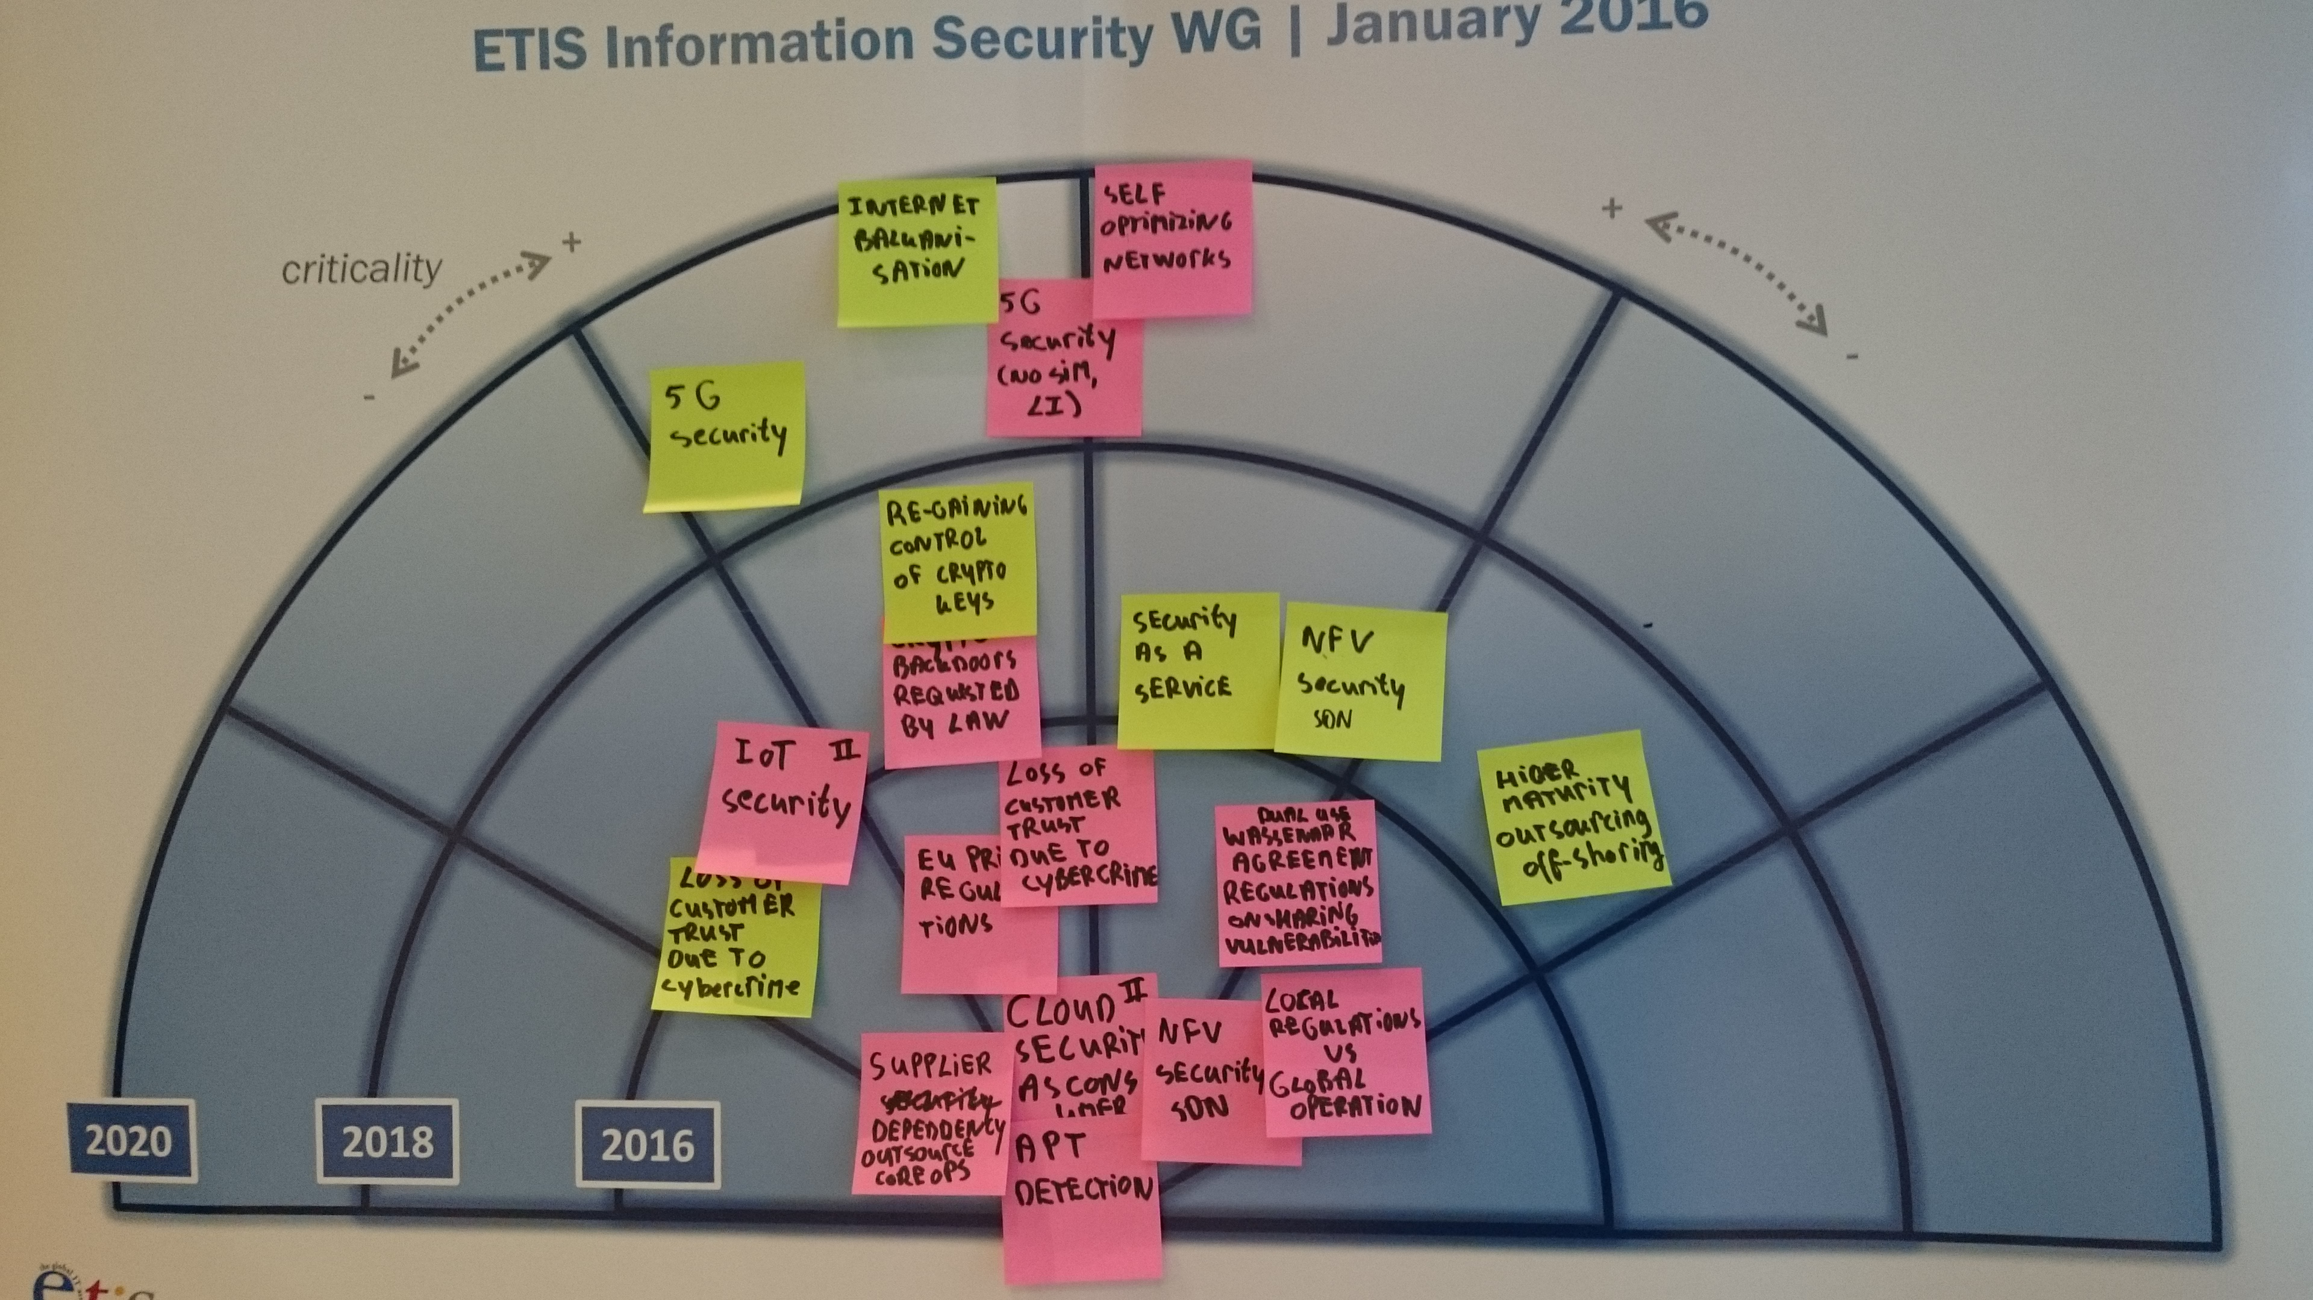


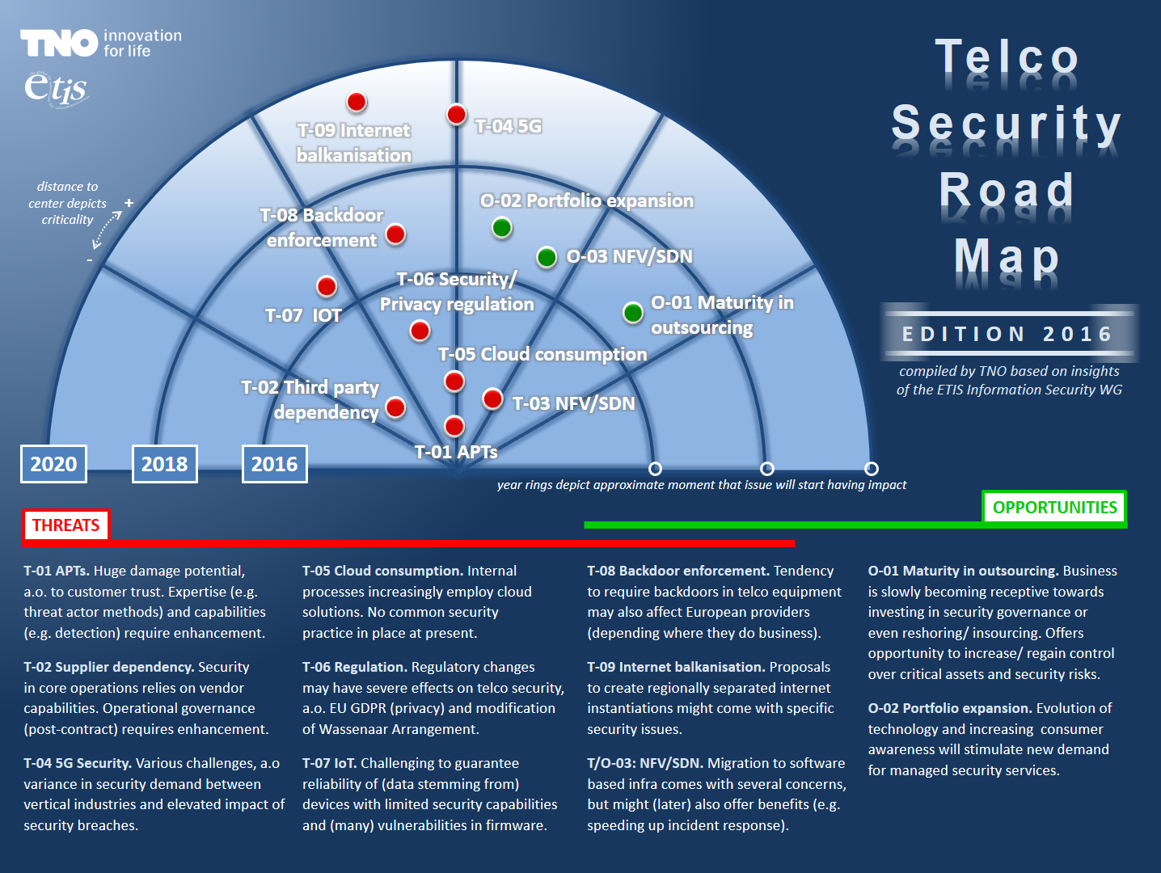
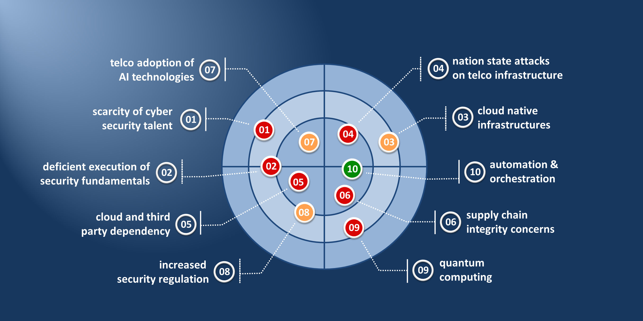

now an
annual
ET-ISAC publication
several changes in format and naming
conceived early 2016
objective: maintain structural foresight (industry wide perspective) to guide ISAC agendas and activities
updated annually
all content stems from dialogue among the telco security specialists and coordinators within the group

Slide 7
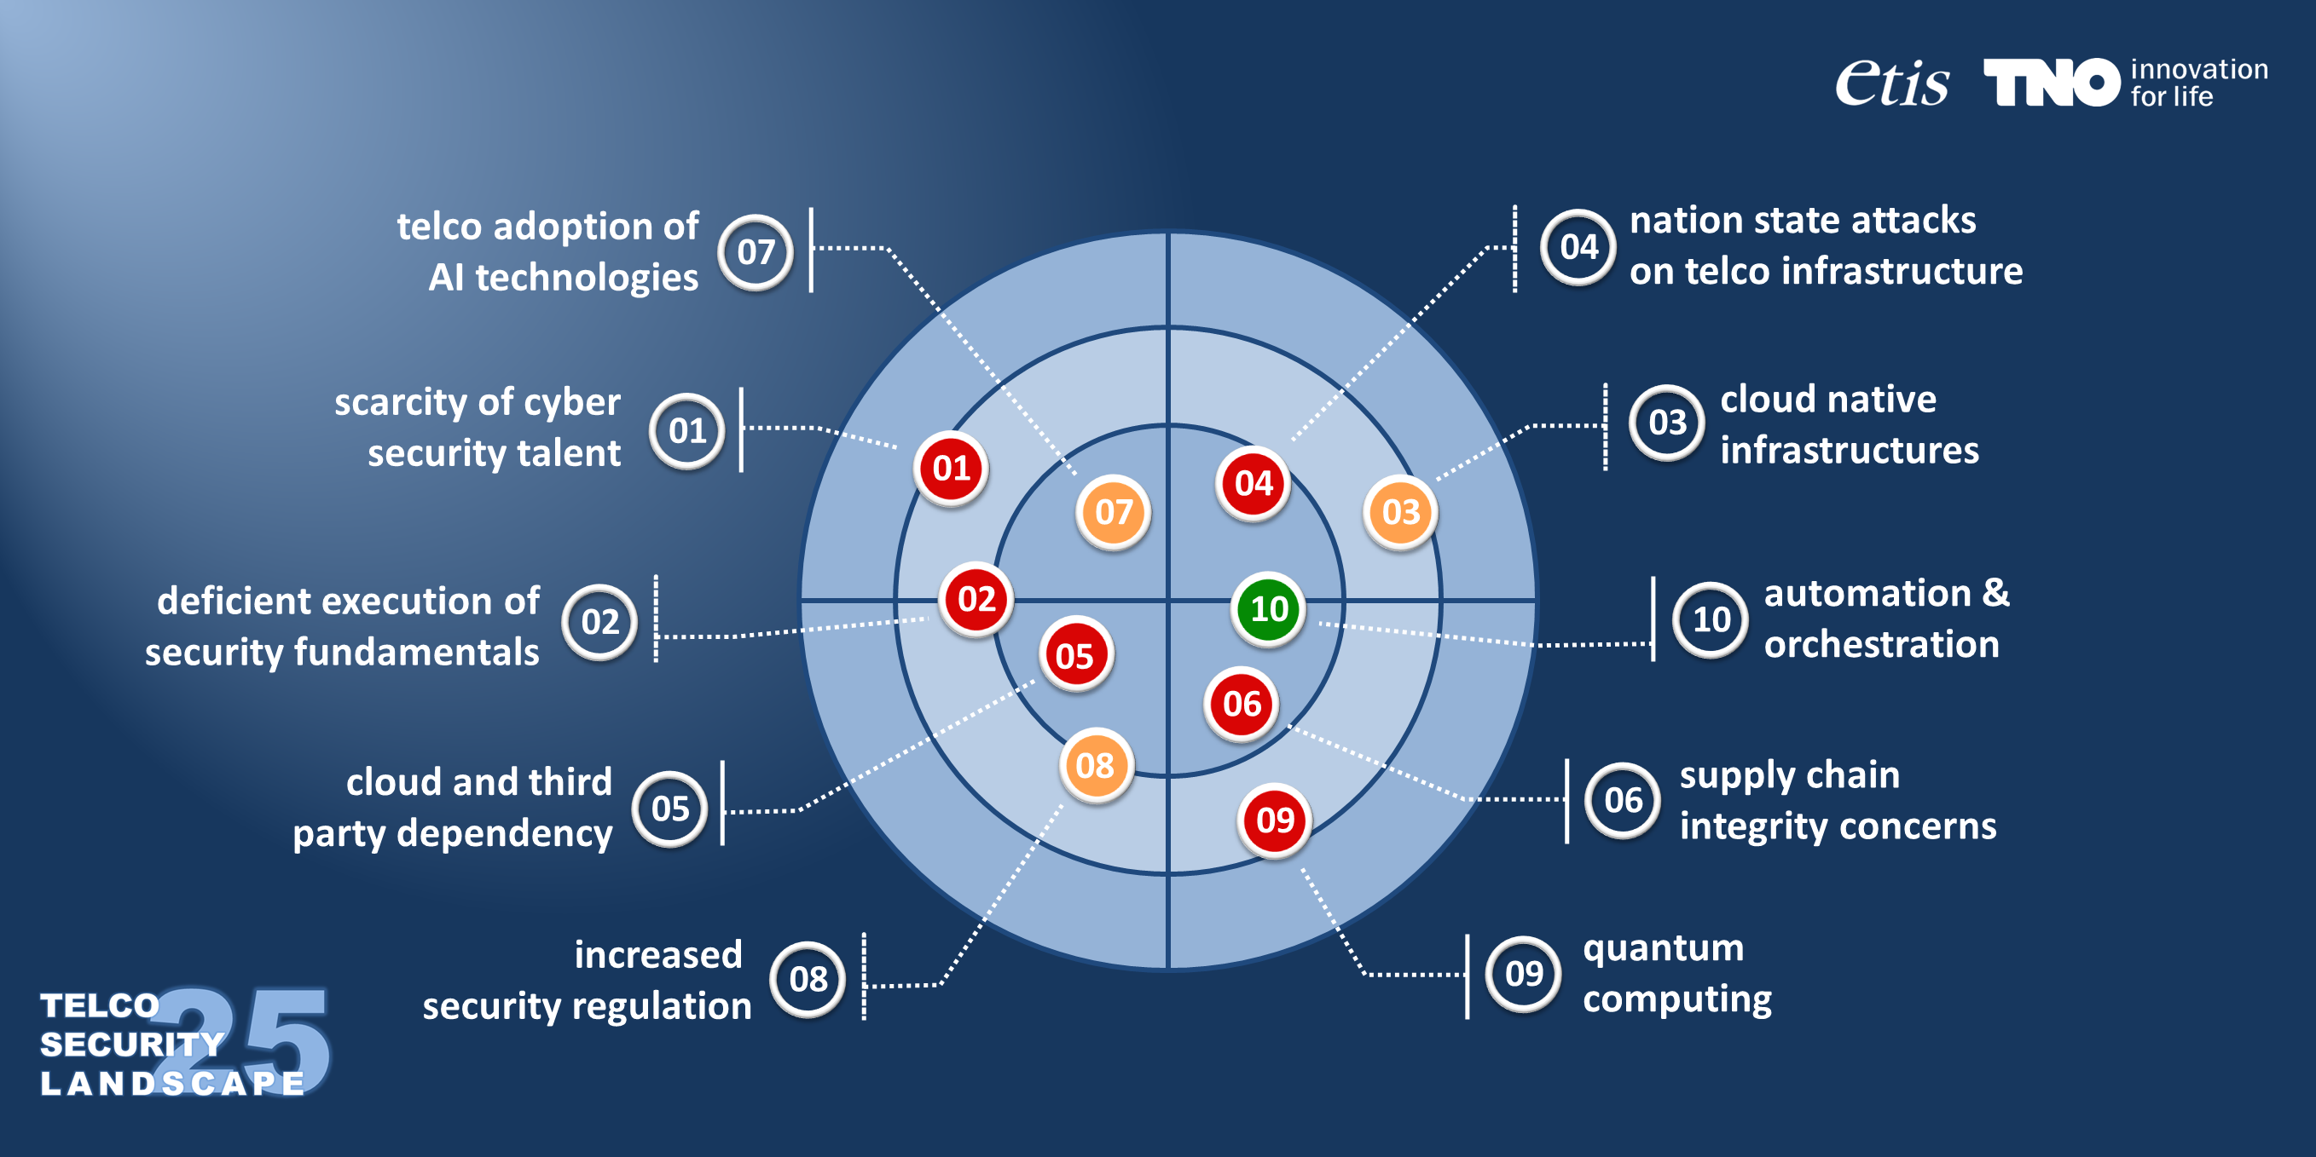



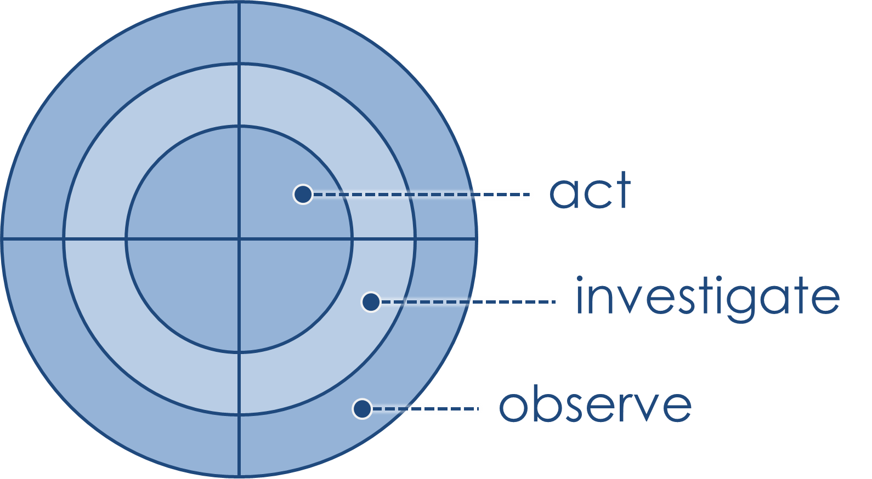
Update landscape for 2025
= threat
= opportunity
= both

Slide 8


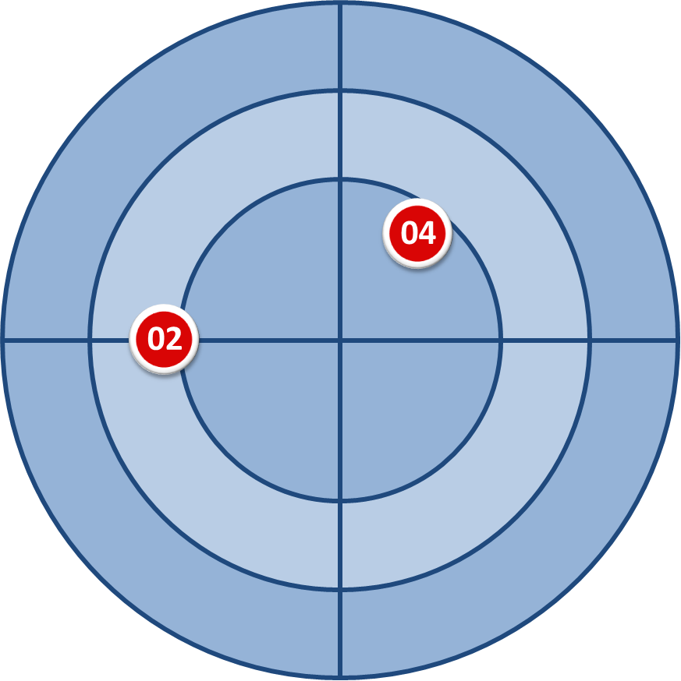
So what’s new…
deficient execution of security fundamentals
nation state attacks
on telco infrastructure
heterogenous technology
stack and need to support
legacy protocols
challenges in consistently
deploying fundamental
security baselines
actors will systematically leverage any vulnerabilities present
telcos increasingly targeted
by state sponsored disruption, espionage and prepositioning
need to adjust resilience
plans to new reality of threats
(Salt Typhoon, undersea cables),

Slide 9

…and what are we doing about it?
deficient execution of security fundamentals
increase focus on
governance/ compliance
further enhance
security operations
(re)evaluate
resilience strategies
industry: increase effort to discover and reduce non-conformities and exceptions
ET-ISAC: exchange practices, e.g. on automated/ data driven security governance
industry: automate operations and elevate intel, hunting and red teaming capability
ET-ISAC: extend intel sharing to machine-readable security playbooks (pilot)
industry: evaluate resilience of telco infrastructure for new reality of threats
ET-ISAC: evaluate and compare strategies seen in different European countries
nation state attacks on telco infrastructure

Slide 10
POLICY OUTLOOK
Translating the topics identified in the Landscape into policy recommendations.
Acknowledge the cost of secure and resilient networks and ensure private and public funding
Adopt a new regulatory approach and enable scalability to sustain continued investments
Simplify and harmonise security regulations and streamline reporting obligations
Enhance a competitive European ecosystem in strategic network technologies
Notes:
☑️ Gain industry visibility – Build awareness & credibility
☑️ Connect with key decision-makers – Engage with telcos & peers
☑️ Access exclusive insights – Learn, innovate & stay ahead
☑️ Shape the industry’s future – Contribute to discussions & best practices

Slide 11
BACKUP

Slide 12

INFORMATION SECURITY WORKING GROUP
Serves as a trusted platform for sharing the most recent trends in cyber security, the threat landscape and current developments in security strategies within telcos.
KEY FOCUS AREAS
  Telco security landscape: Regular updates on the most recent trends, risks & challenges & future threats
  Scope: Transformation of telcos into cloud native, Telco Network Security Applicability and challenges of AI, Supply chain security, Cloud and software security, Zero-Trust: defining security architecture, Vendor & Partner management, Emergent security regulations in Europe, Security governance
  Data management & privacy: Risk management, data privacy + infrastructure protection.
PARTICIPANT PROFILE
  Heads of Cyber Security
  CISO, CSO
  Security Leads
  Security Managers
Andrija Višić coordinates the activities for this group.

